Slide 1

Docker-Based HTTPS Reverse Proxy
Supervisor:
Prof. Dr. Martin Leischner
Prepared by:
Hossam Alzamly
Badr Ibrahim
WS17/18

Slide 2
Outline
WS17/18
Objective
Glance at the final result
Why?
How?
Scenario
Components
Implementation

Slide 3
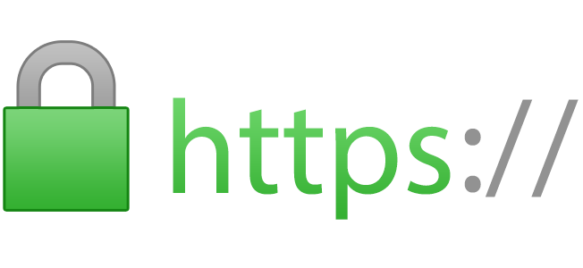
OBJECTIVE
WS17/18
The objective of this project is to setup a Docker-Based HTTPS Reverse Proxy for securing web services.

Slide 4
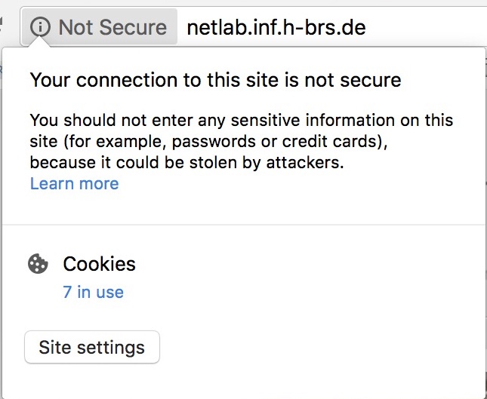
FINAL RESULT Example: http://netlab.inf.h-brs.de
WS17/18

Slide 5
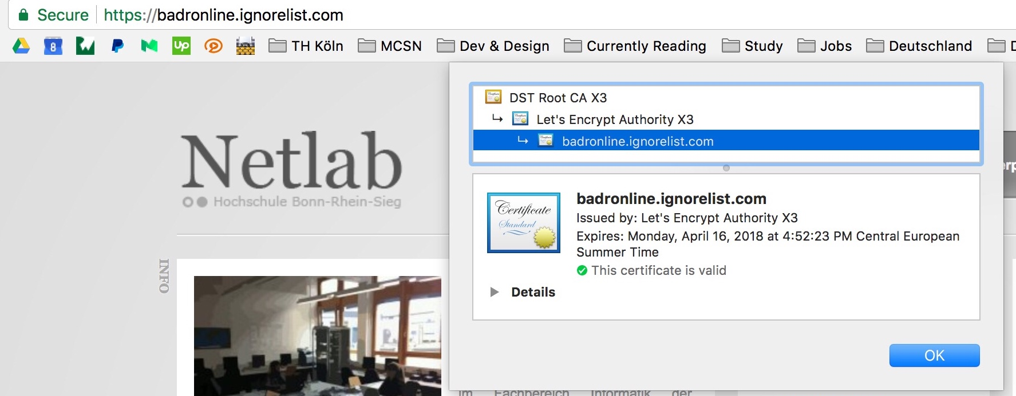

FINAL RESULT Example: http://netlab.inf.h-brs.de
WS17/18

Slide 6

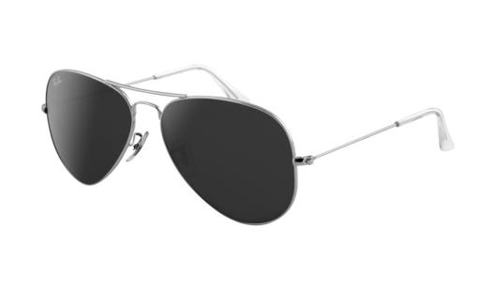
WHY?
WS17/18
Some web servers do not implement https and use http instead.
Using http in login page puts confidential information (e.g. passwords) at risk.
A rapid, easy maintained and deployed solution is needed instead of reconfiguring every web server.
That’s
Me!

Slide 7
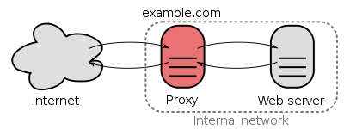
HOW?
WS17/18
A reverse proxy is a type of proxy server that retrieves resources on behalf of a client from one or more servers. These resources are then returned to the client as if they originated from the Web server itself.
Source: https://en.wikipedia.org/wiki/Reverse_proxy
A reverse proxy taking requests from the Internet and forwarding them to servers in an internal network. Those making requests to the proxy may not be aware of the internal network.

Slide 8
HOW?
WS17/18
Client from internet reaches the web server at the reverse proxy’s domain name.
The reverse proxy handles setting up the https connection. (Certificate is needed!)

Slide 9
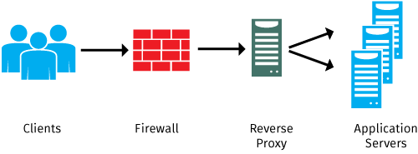
Diagram for a reverse proxy
WS17/18
Source: https://kemptechnologies.com

Slide 10
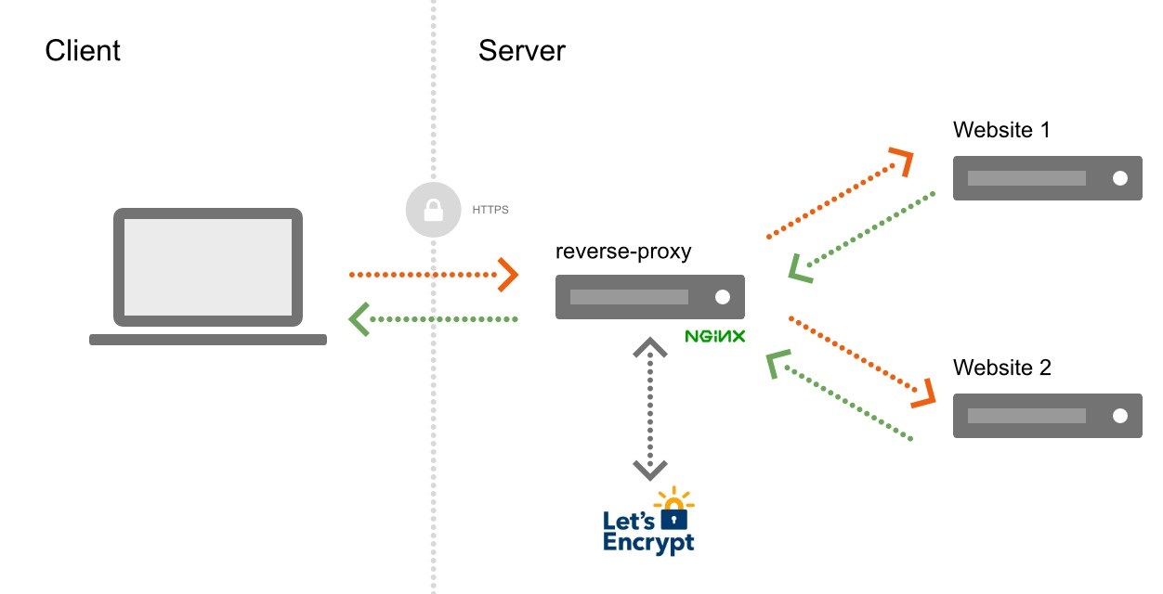
Scenario
WS17/18
Netlab web server
CA’s Client
Reverse Proxy
Container
Cert. Req.
Challenges
Custom web server
CA : Certificate Authority
Source: medium.com/@François Romain

Slide 11
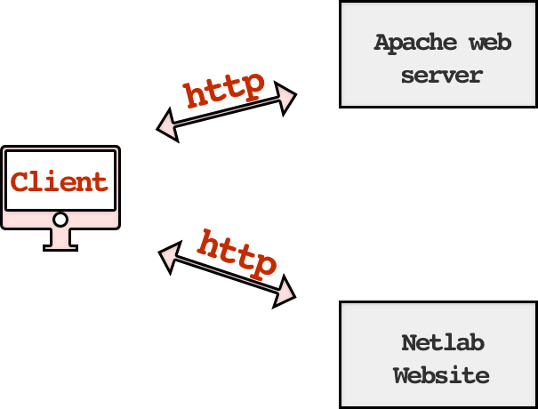
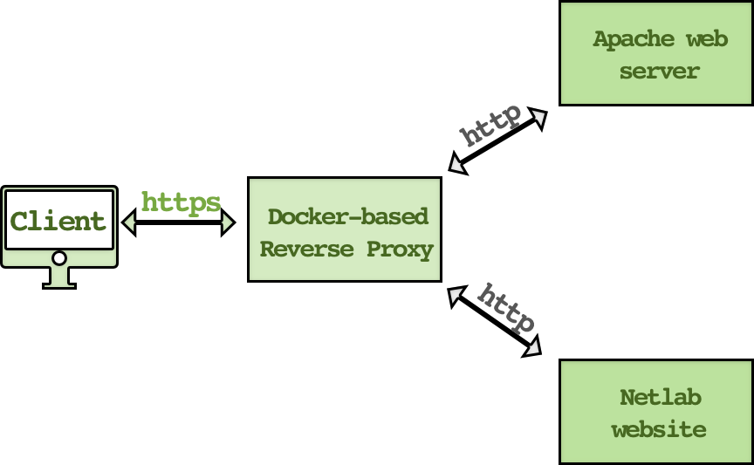
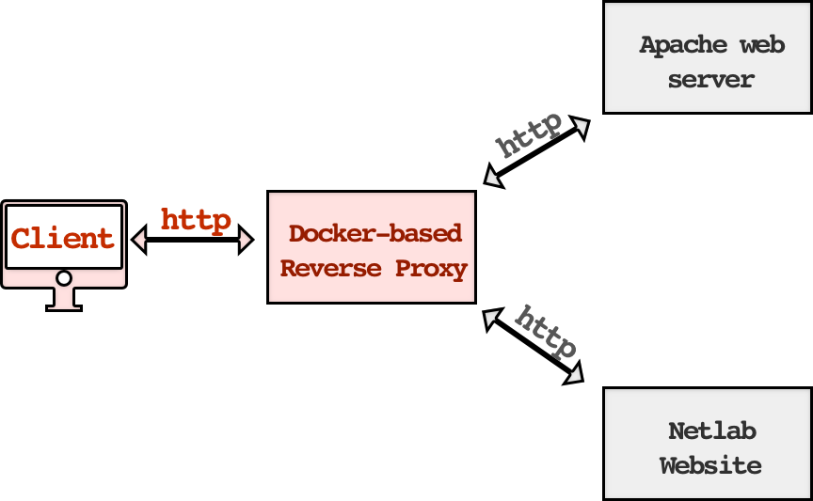


SCENARIO
WS17/18
NGINX
NGINX
Request Certificate

Slide 12
COMPONENTS
WS17/18
Docker engine installed on a hosting machine.
Reverse proxy docker container.
Web servers to be proxied/secured.
Certificate Authorities (CA) i.e. Let’s Encrypt.
CA Client.

Slide 13


DOCKER ENGINE
WS17/18
Docker engine must installed on the hosting machine which has a valid domain name.
We bought a hosting machine from DigitalOcean and got a registered free domain name by freedns.afraid.org.

Slide 14

REVERSE PROXY
WS17/18
NGINX is used as reverse proxy.
Configuration file resides in the path: /etc/nginx/nginx.conf

Slide 15

WEB SERVERS
WS17/18
Apache is used as for the custom web server.
Netlab web server is used as well.
Configuration file of ports is in the file: /etc/apache2/ports.conf

Slide 16
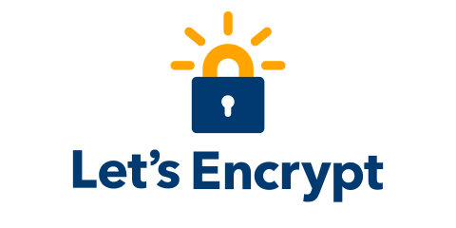
CERTIFICATE AUTHORITY
WS17/18
Let’s Encrypt is a free, automated, and open Certificate Authority launched by the EFF, Mozilla, and others.
One must be aware of the limitations; Max of 20/week and 5/hour per registrar.

Slide 17

CA CLIENT
WS17/18
Certbot is free client that was created by EFF to automate important operations such as; certificate requesting, renewing and revoking.

Slide 18
IMPLEMENTATION: Dockerfile Create a Dockerfile doing the following 2 main tasks:
WS17/18
Install nginx and all the required packages for Certbot inside a Docker container:
FROM ubuntu
RUN apt-get update && \
apt-get -y install nginx-full && \
apt-get -y install software-properties-common && \
apt-get -y upgrade && \
add-apt-repository ppa:certbot/certbot-build && \
apt-get update && \
apt-get -y install python-certbot-nginx && \
apt-get autoremove -y

Slide 19
IMPLEMENTATION: Dockerfile cont.
WS17/18
Obtaining and installing certificates:
We use nginx plugin and standanlone plugin to get and install certificate, and modifying nginx.conf automatically to enable https by the following command:
CMD certbot --authenticator standalone --installer nginx --pre-hook "service nginx stop" --post-hook "service nginx start“ --keep && bash
All generated keys and issued certificates can be found in /etc/letsencrypt/live/$domain
Additional SSL configurations will be added by certbot inside relative server section in nginx.conf was as follow:
listen 443 ssl;
ssl_certificate /etc/letsencrypt/live/badronline.crabdance.com/fullchain.pem;
ssl_certificate_key /etc/letsencrypt/live/badronline.crabdance.com/privkey.pem;
include /etc/letsencrypt/options-ssl-nginx.conf;
ssl_dhparam /etc/letsencrypt/ssl-dhparams.pem;

Slide 20
IMPLEMENTATION: Automating renewal
WS17/18
Let’s Encrypt certificate expire every 90 days so it’s sensible to add auto renewal feature offered be certbot.
Automatic renewal can be configured by configuring the cli.ini file for auto renewal. (Add the following line)
renew-by-default = true
One can test the certificates renewal by running this command:
$ sudo certbot renew --dry-run

Slide 21
IMPLEMENTATION: Run command
WS17/18
docker run -it -p 80:80 -p 443:443 -v $(pwd)/letsencrypt:/etc/letsencrypt
-v $(pwd)/nginx.conf:/etc/nginx/nginx.conf myImage

Slide 22
IMPLEMENTATION: Managing certificates
WS17/18
View a list of the certificates Certbot knows about
certbot certificates
Re-creating and Updating Existing Certificates
certbot --expand -d existing.com,example.com,newdomain.com
Changing a Certificate’s Domains
certbot certonly --cert-name example.com -d example.com
Revoking certificates
certbot revoke --cert-path path-to-certificate
Remove certificate and all relative configurations
certbot delete --cert-name example.com

Slide 23
DEMOSTRATION
WS17/18

Slide 24
WHAT TO-DO
WS17/18
Open the http websites themselves.
Show the https connection for both websites.
Running the container.
Dive in the Docker file.

Slide 25
WHAT TO-DO
WS17/18

Slide 26

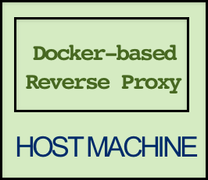
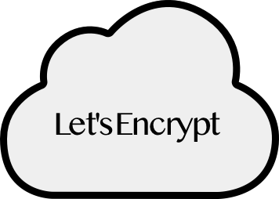
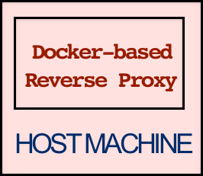



CHALLENGES
WS17/18

Slide 27
CHALLENGES
WS17/18
ACME protocol is used to define the messages.
The messages are carried over http with body of JSON.
Challenges used to prove control over the domain the certificate is needed for.
Challenges has three types:
http-01 : on port 80 (The one used in the project)
tls-sni-01 : on port 443 (Currently stopped due to security issue)
dns-01 : on port 53 (Not available for Standalone plugin)

Slide 28
Resources
WS17/18
Docker : https://docs.docker.com/
NGINX : https://www.nginx.com/resources/wiki/start/index.html
LetsEncrypt : https://letsencrypt.org/docs/
Certbot : https://certbot.eff.org/docs/
https://ietf-wg-acme.github.io/acme/draft-ietf-acme-acme.html
Digital Ocean : https://cloud.digitalocean.com
Free DNS : http://freedns.afraid.org/

Slide 29
Questions?
Thank you ..

